Slide 1
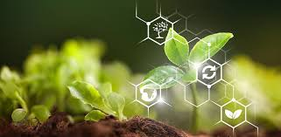
SMARTFARMER - IOT ENABLED SMART FARMING APPLICATION
TEAM MEMBERS:
TEAM ID - PNT2022TMID03050 AJAYSARRAN M
ABINITHI M
ABITH SINGH S
AKASH B

Slide 2
PROJECT OVERVIEW
In order to evaluate the overall outcome of the SmartFarming sub use cases, their economic and environmental benefits,
social aspects, and the technical evolution path were evaluated.
In order to quantify economic benefit of FutureInternet technology to the farmer, a business case was analyzed.
Smart Farming can benefit by improving irrigation, site-specific pesticide application and lower energy consumption.
The examination of the social aspects shows that the highest benefit is seen in the possibility to learn and to develop new
competencies for farmers.
The technical evolution prospects of the pilots is analyzed regarding extensibility , flexibility , scalability
(how big is big data), and portability.
The future development plan is discussed. It would be very important to involve the policy, government,
and regulatory aspects into the development work.

Slide 3
Problem statement
The soil moisture sensor measures wetness content in the soil.
The Arduino UNO microcontroller used to receive input from a various sensors and it can be controlled automatically. When soil moisture sensor goes low the water pump will be on and it exceeds defined levels of the water motor will turn off automatically.
We can constantly monitor the growth of a crop using ultrasonic sensor. PIR sensor detects the motion or unusual movement in the agricultural land.
This device his very helpful to the former to monitor and control environmental parameters at their field.
The farmers did not go to theirfield, they can remotely monitor and control using cloud

Slide 4
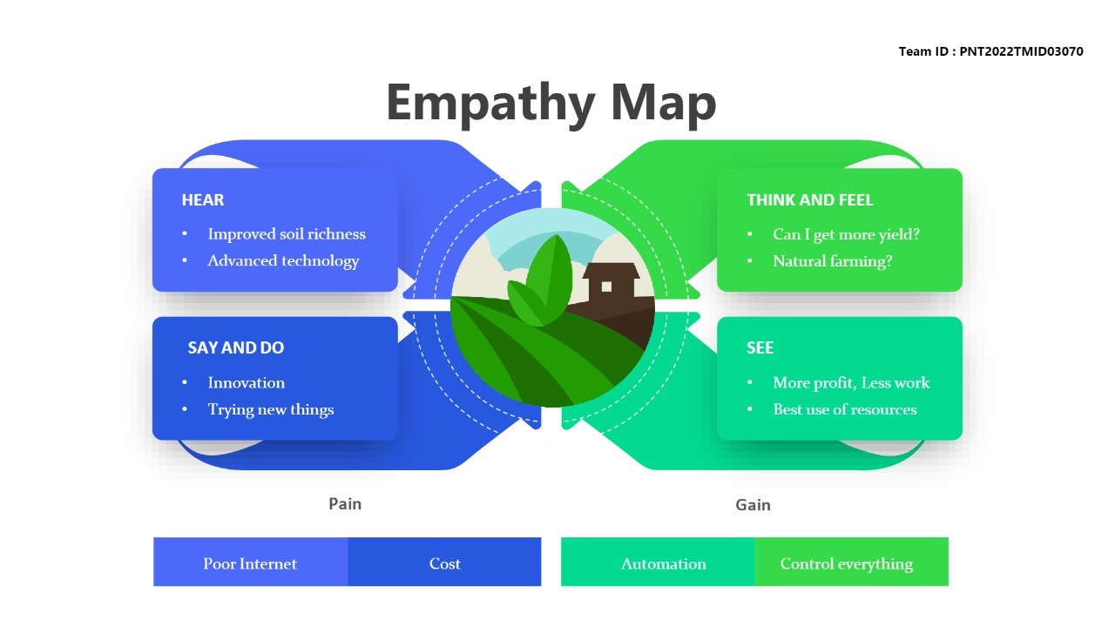
EMPATHY MAP

Slide 5
PROPOSED SOLUTION AND NOVELTY
Smart Agricultural System solutions provide an integrated lot platform in agriculture that allows farmers to leverage sensors, smart gateways and monitoring systems to collect information,
To control various parameters on their farms and analyze real-time data in order to make informed decisions.
Various eminent researchers have been making efforts for smart farming by using lot concepts in agriculture.
But, a bouquet of unfolded challenges is still in a queue for their effective solution.
This study makes some efforts to discuss past research and open challenges in loT based agriculture.

Slide 6
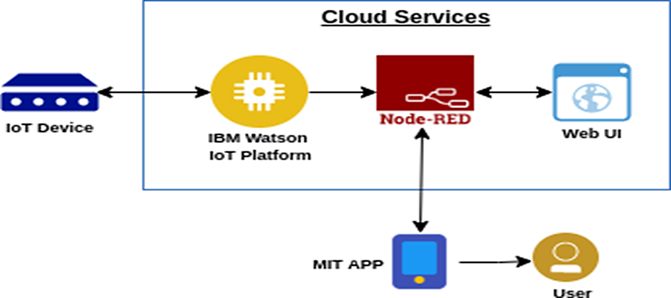
ARCHITECTURE

Slide 7
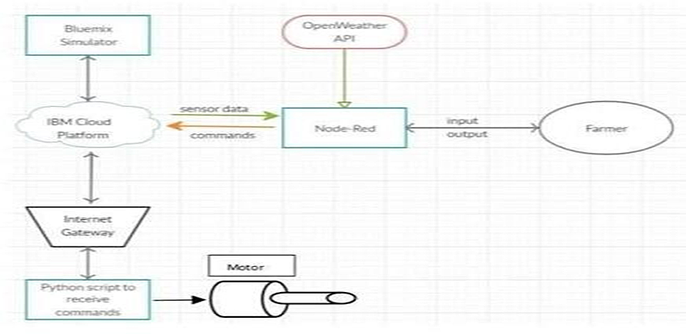
SOLUTION

Slide 8
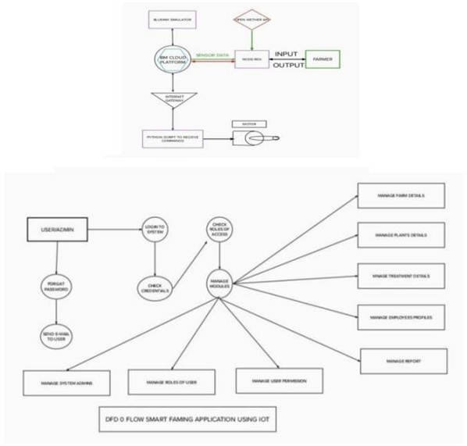
DATA FLOW DIAGRAM

Slide 9
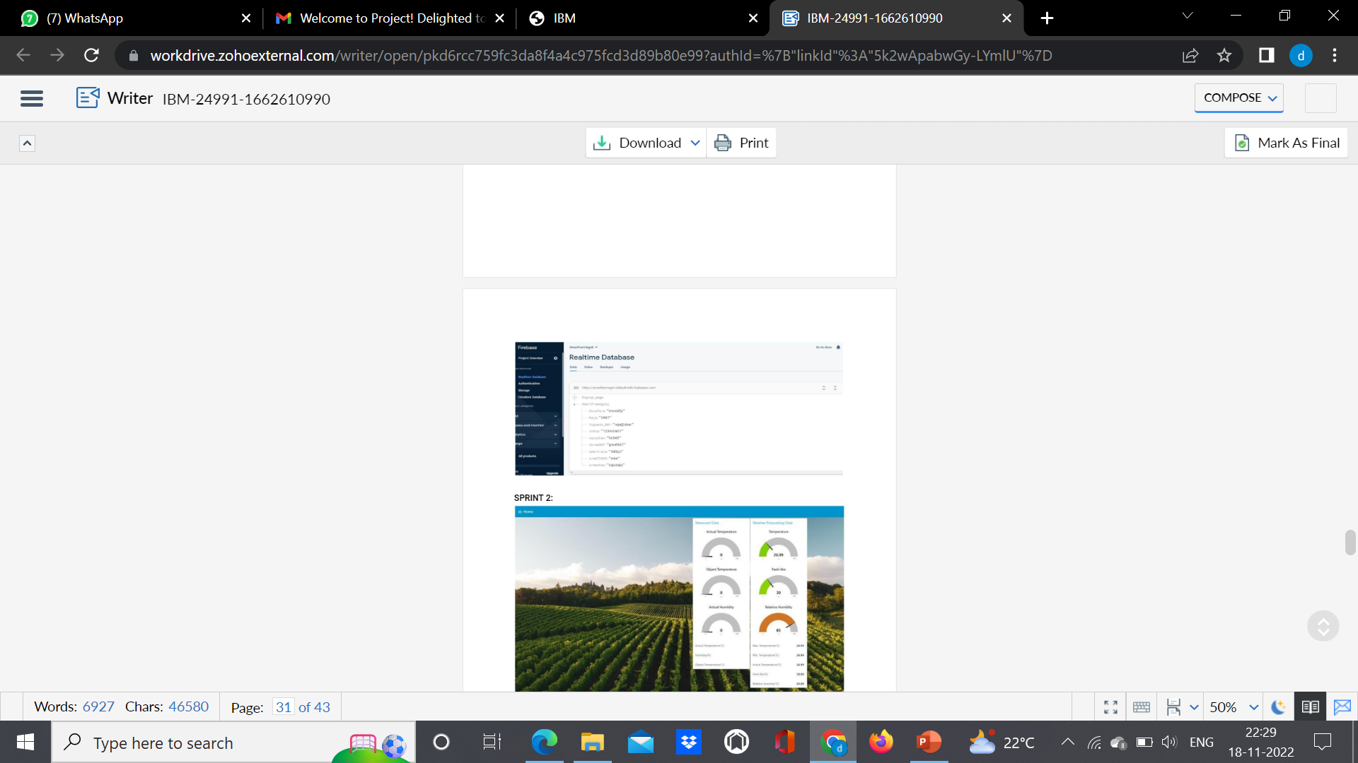
DEVELOPMENT PHASE

Slide 10
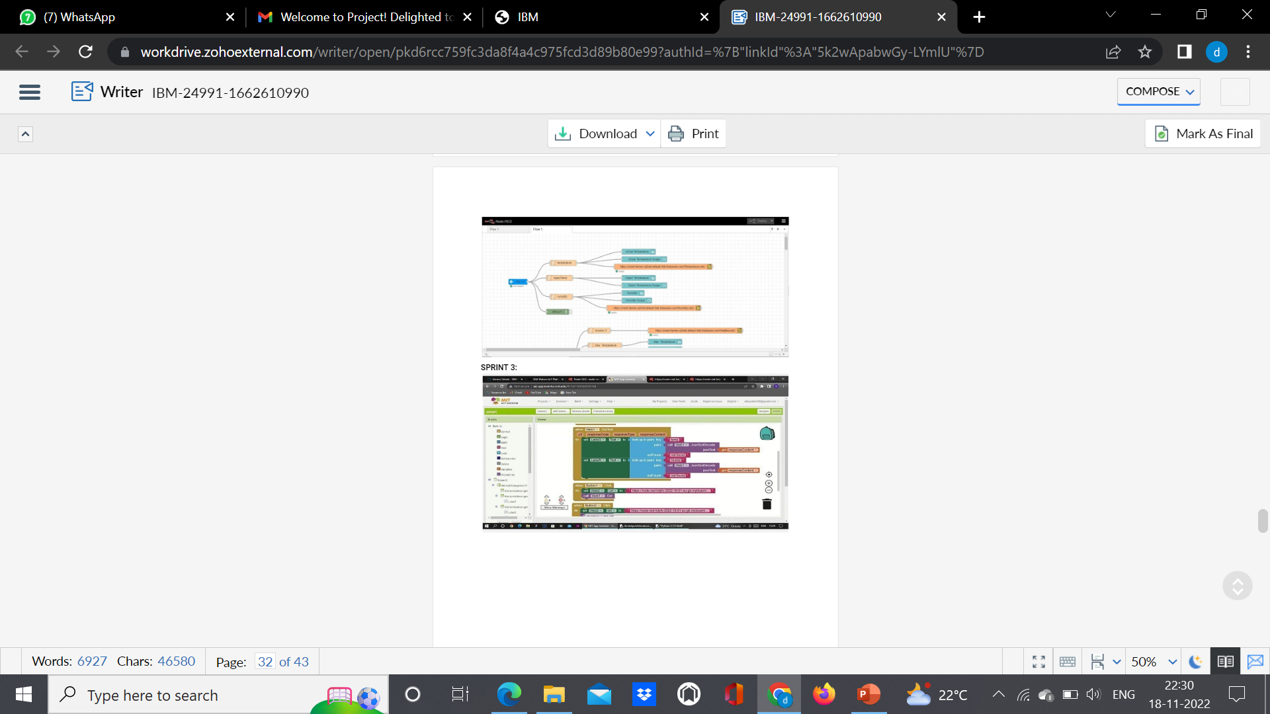

Slide 11
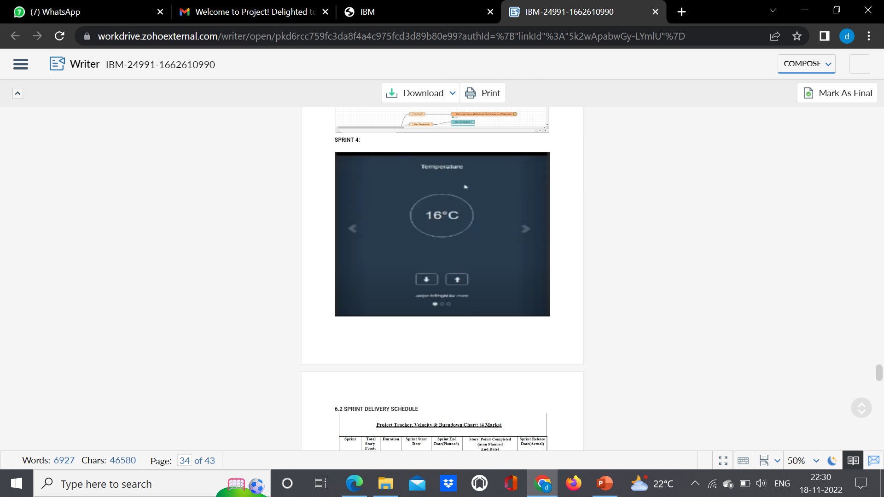

Slide 12
THANKYOU

